Slide 1
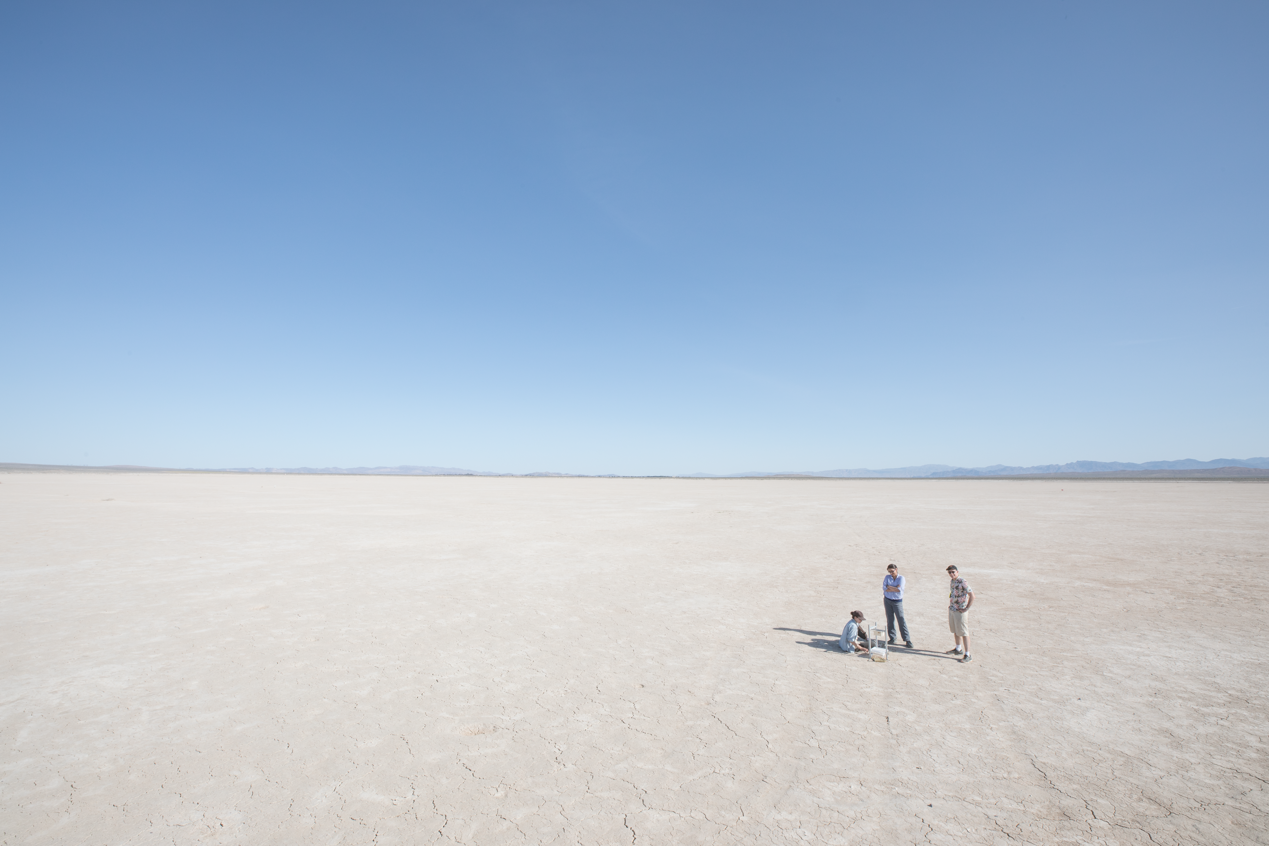
Characterizing the dispersal of flying insects in the field, using sky-facing cameras
Francesca V. Ponce
April 2022

Slide 2
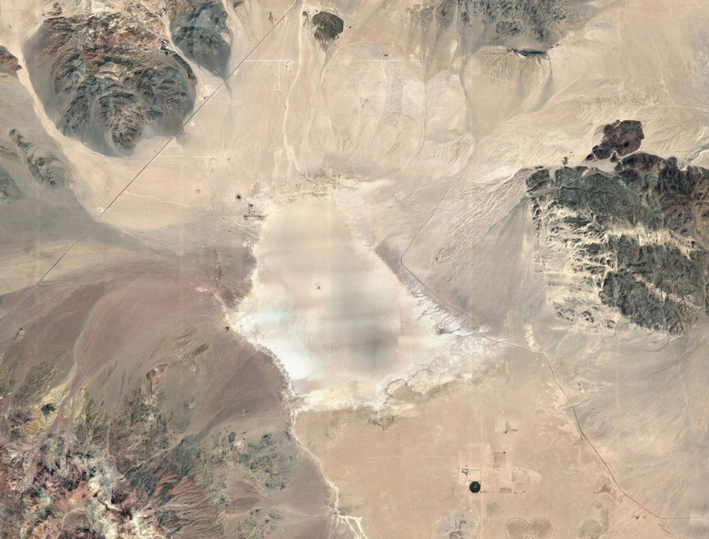
Coyote Lake
2 km
traps
release site

Slide 3
Coyote Lake
Notes:
looking ENE from roughly the middle of coyote lake
(roughly 5 minutes to get to this point)

Slide 4
30 000 flies - ready to go

Slide 5
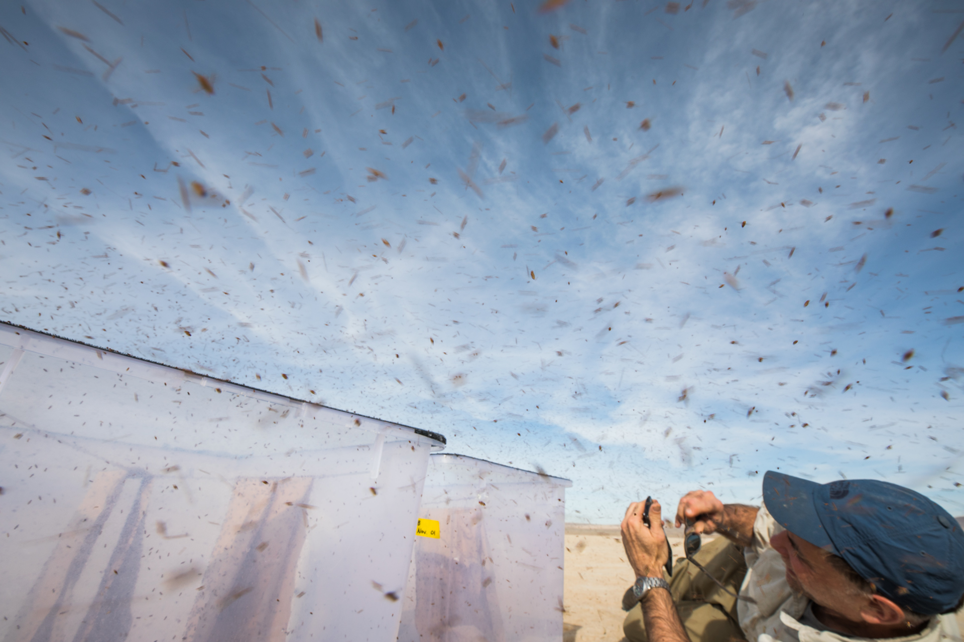
30 000 flies - going

